Slide 1
Dynamic systems with applications S22
GROUP 9
Katharina Brarup Schäfer, Frederik Fristed, Petar Gavran, Rune Marsilius Jensen & Thea Gorzelak

Slide 2


Agenda
Elevator with flexible ropes (10 min)
Wind turbine – 3D rotor with flexible tower (10 min)
Wind turbine – 2D rotor with flexible tower and blades (10 min)

Slide 3
Elevator with flexible ropes

Slide 4
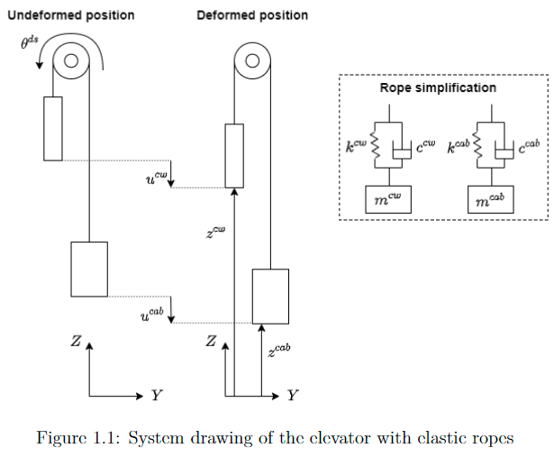
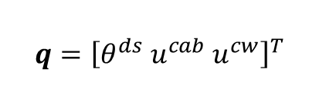
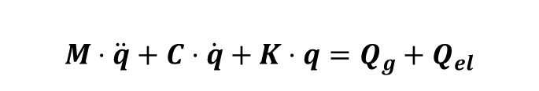
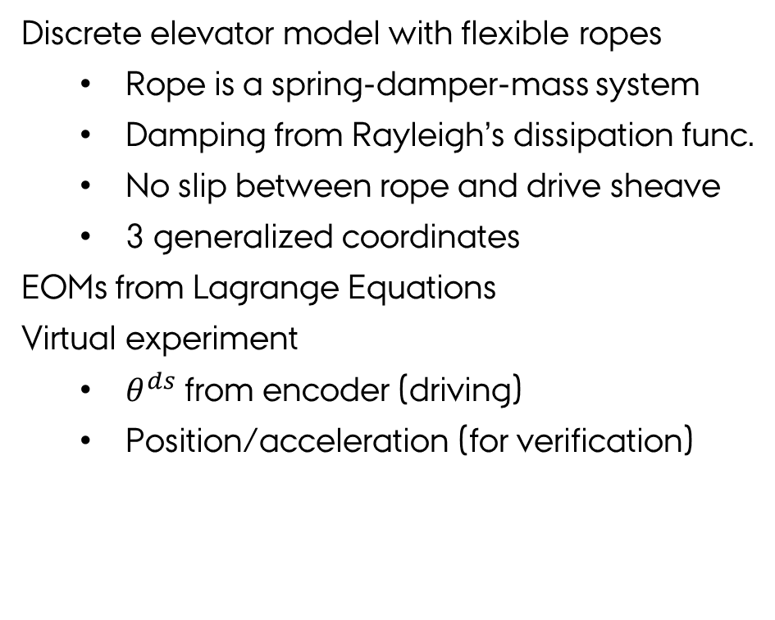
Elevator model & EOM
ELEVATOR
3D RFT
2D RFT-B
$$q={\left[θ^{ds} u^{cab} u^{cw}\right]}^{T}$$
Discrete elevator model with flexible ropes
Rope is a spring-damper-mass system
Damping from Rayleigh’s dissipation func.
No slip between rope and drive sheave
3 generalized coordinates
EOMs from Lagrange Equations
Virtual experiment
$θ^{ds}$ from encoder (driving)
Position/acceleration (for verification)
$$M⋅\ddot{q}+C⋅\dot{q}+K⋅q=Q_{g}+Q_{el}$$
Notes:
frederik

Slide 5
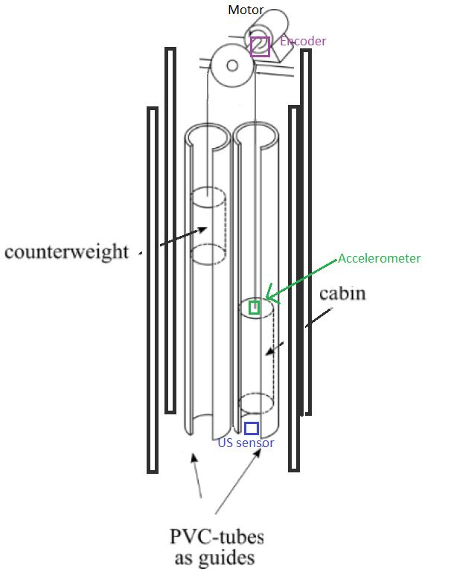
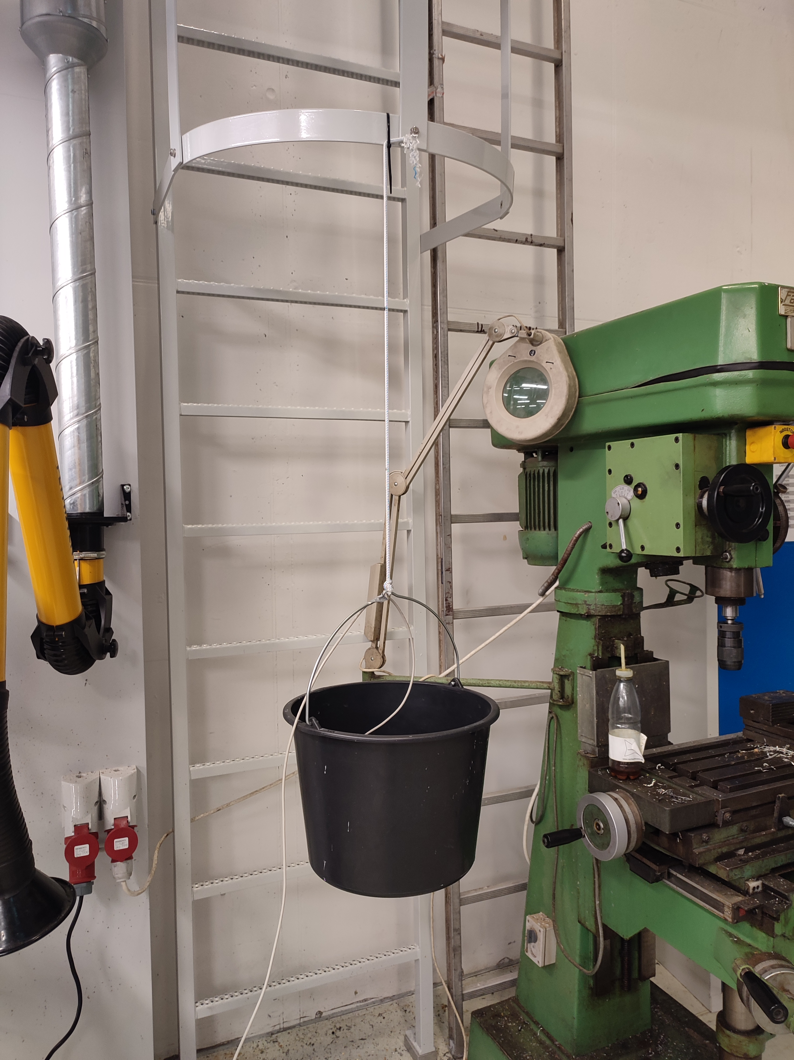
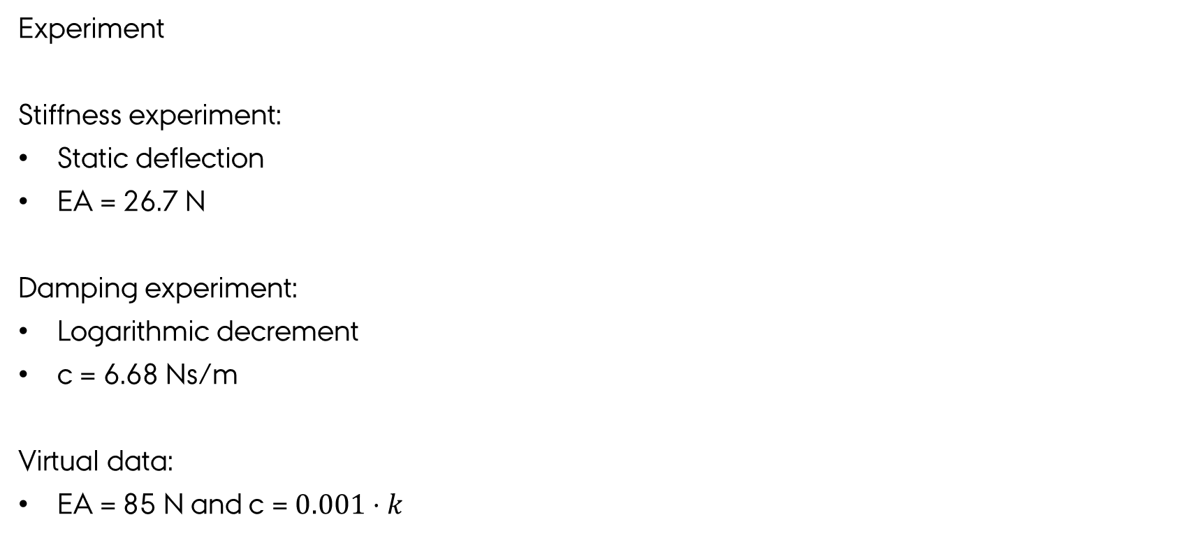
Experiment & parameters
ELEVATOR
3D RFT
2D RFT-B
Experiment
Stiffness experiment:
Static deflection
EA = 26.7 N
Damping experiment:
Logarithmic decrement
c = 6.68 Ns/m
Virtual data:
EA = 85 N and c = $0.001⋅k$
Notes:
katharina

Slide 6
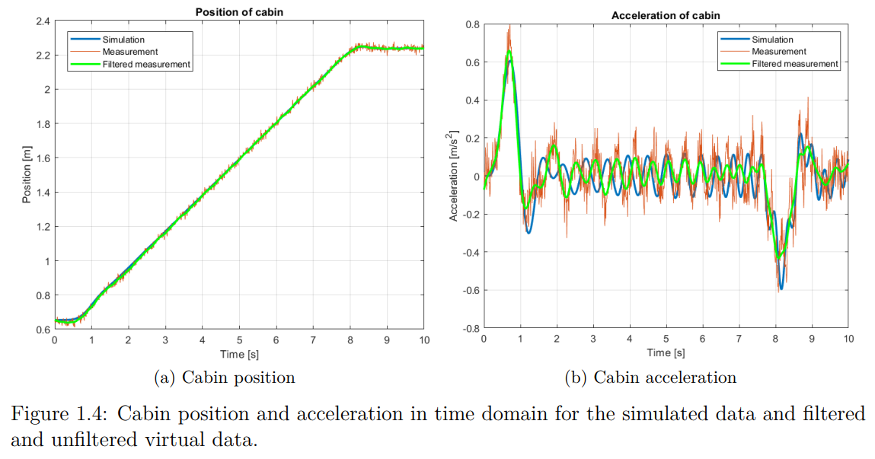
Signal processing

Slide 7
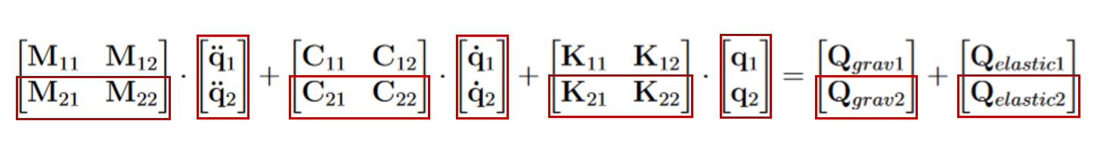
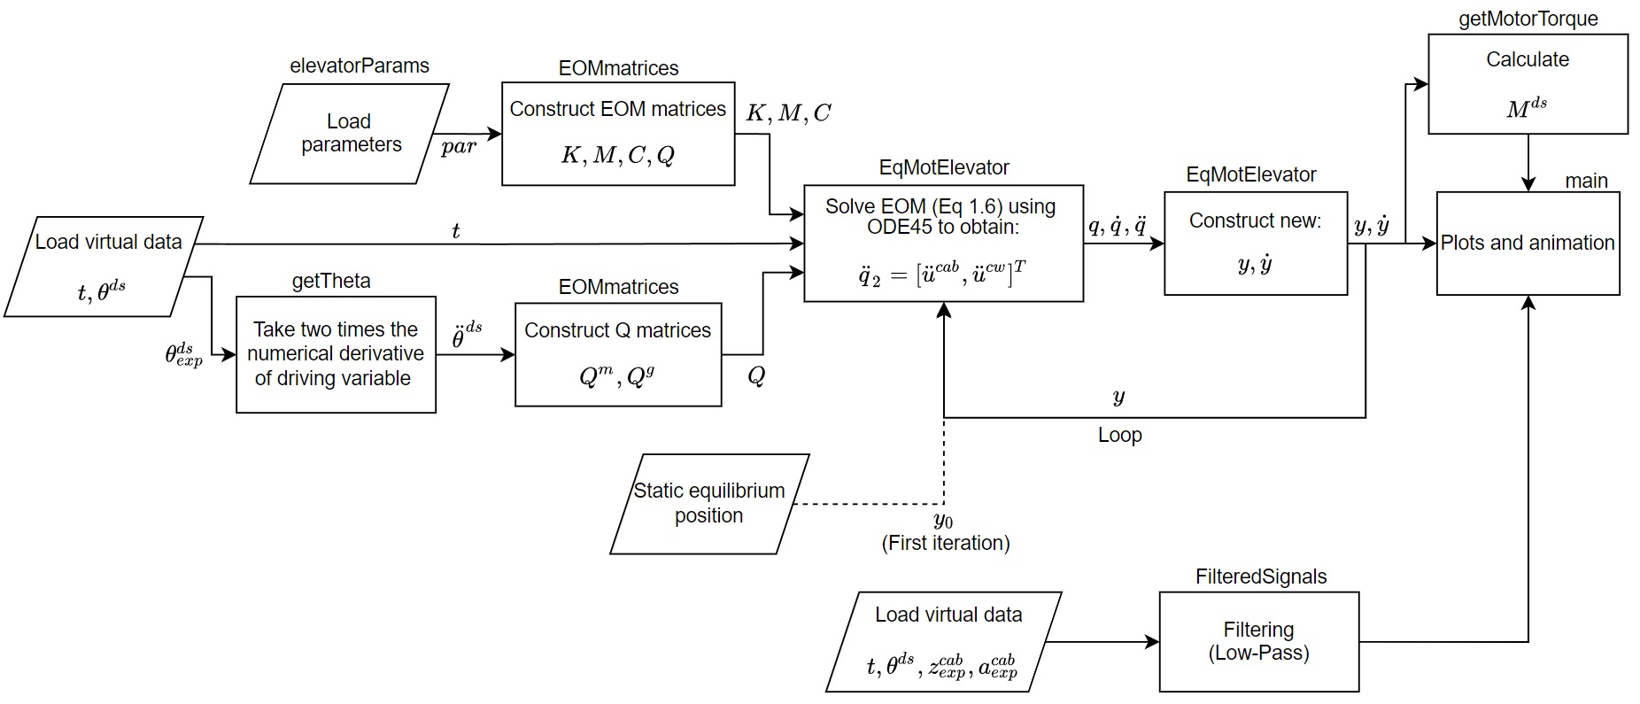
Simulation
ELEVATOR
3D RFT
2D RFT-B

Slide 8
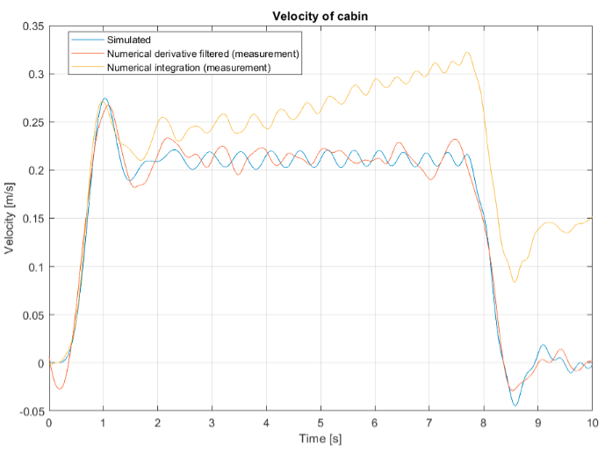
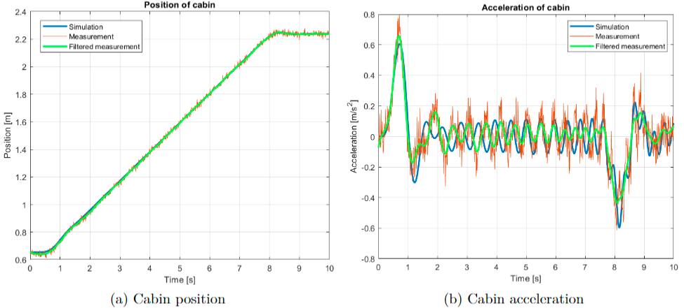
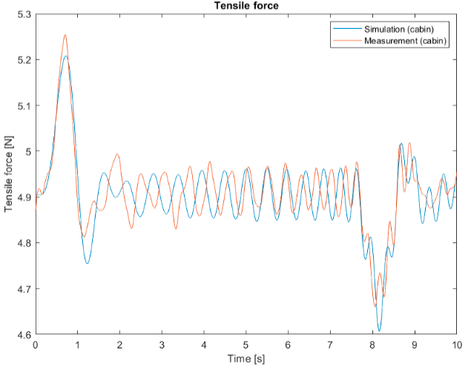
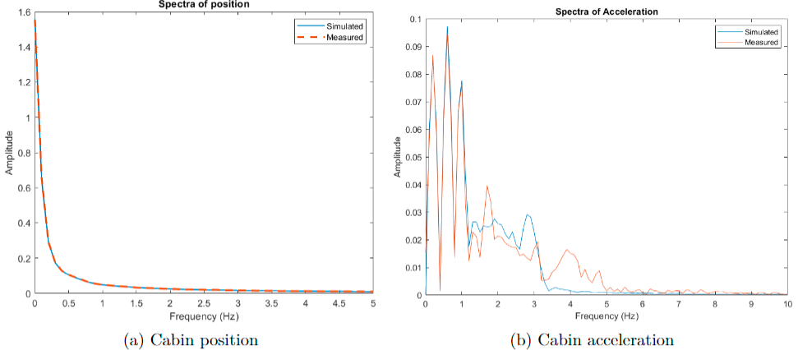
Results & comparison
ELEVATOR
3D RFT
2D RFT-B

Slide 9
Conclusion
ELEVATOR
3D RFT
2D RFT-B
Succesfully modelled a discrete elevator-system with flexible ropes.
Comparison to virtual experiment.
Experimentally determined rope stiffness and damping.
Digital signal processing on data from virtual experiment.
Results from numerical simulation compared with results from virtual experiment.
Notes:
Thea

Slide 11
Wind turbine (RFT) 3D Rotor with flexible tower

Slide 12
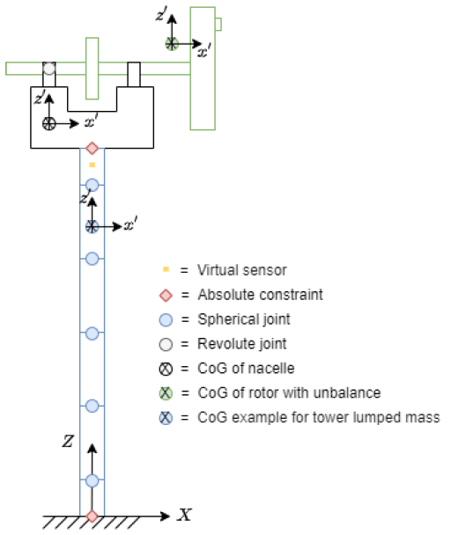
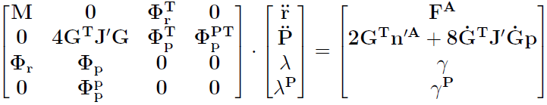
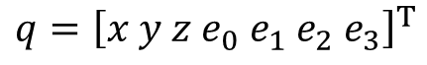
3D model & EOm
ELEVATOR
3D RFT
2D RFT-B
Rigid nacelle and rotor.
Flexible tower using lumped mass approach
Connected using spherical and revolute joints and absolute constraints.
Rotational spring-damper elements
Generalized coordinates:
Equations of Motion:
$$q={\left[x y z e_{0} e_{1} e_{2} e_{3}\right]}^{T}$$
Virtual sensor
Notes:
Thea
Multibody-part (lumped masses) and lengths of lumped masses.
Different kinds of joints.
Initial conditions.
Applied forces

Slide 13
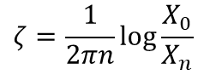
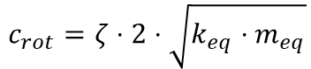
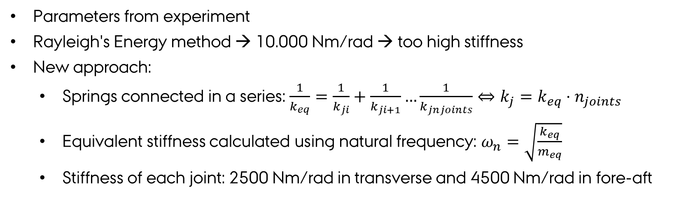
Identification of parameters
ELEVATOR
3D RFT
2D RFT-B
Parameters from experiment
Rayleigh's Energy method → 10.000 Nm/rad → too high stiffness
New approach:
Springs connected in a series: $\frac{1}{k_{eq}}=\frac{1}{k_{ji}}+\frac{1}{k_{ji+1}}…\frac{1}{k_{jnjoints}}⇔k_{j}=k_{eq}⋅n_{joints}$
Equivalent stiffness calculated using natural frequency: $ω_{n}=\sqrt{\frac{k_{eq}}{m_{eq}}}$
Stiffness of each joint: 2500 Nm/rad in transverse and 4500 Nm/rad in fore-aft
$$ζ=\frac{1}{2πn}\log{\frac{X_{0}}{X_{n}}}$$
$$c_{rot}=ζ⋅2⋅\sqrt{k_{eq}⋅m_{eq}}$$
Torsional damping:
Notes:
Thea
Stiffness and damping

Slide 14
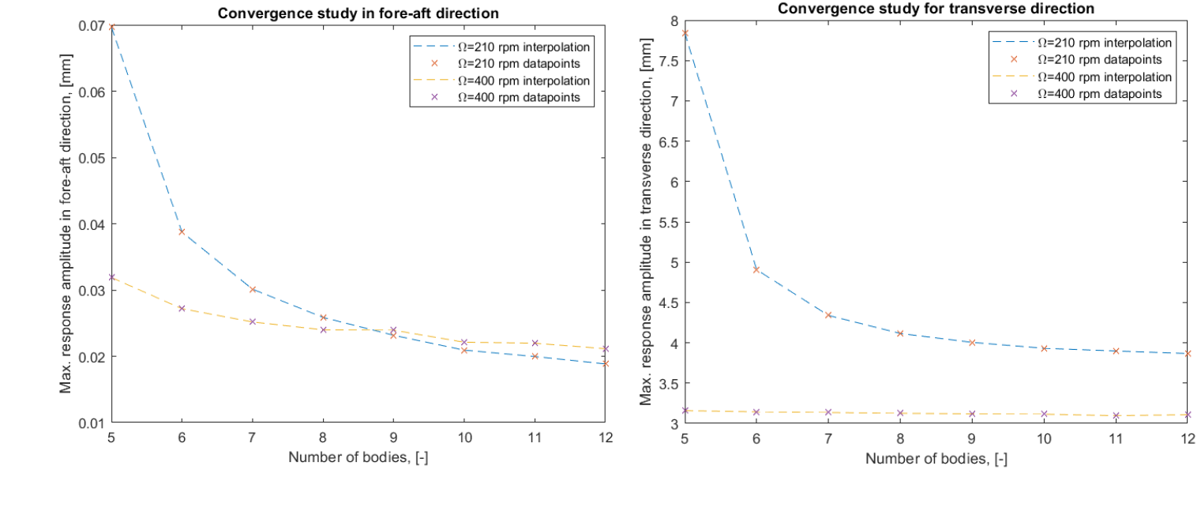
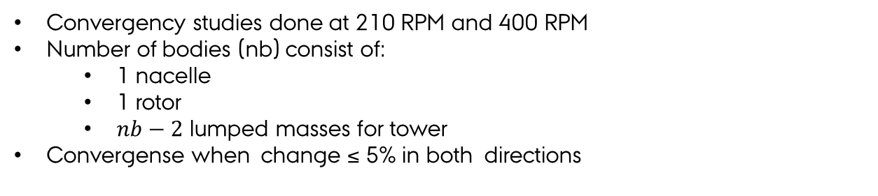
Convergency study
ELEVATOR
3D RFT
2D RFT-B
Convergency studies done at 210 RPM and 400 RPM
Number of bodies (nb) consist of:
1 nacelle
1 rotor
$nb−2$ lumped masses for tower
Convergense when change ≤ 5% in both directions
Notes:
Thea
Min. amount of bodies is 5 → 3 lumped masses in tower, first and last being half size of the middle bodies.
Fig. shows maximum deflection of virtual sensor for rotational speeds of 210 and 400 RPM.
Calculations showing <5%?
Why it converges

Slide 15
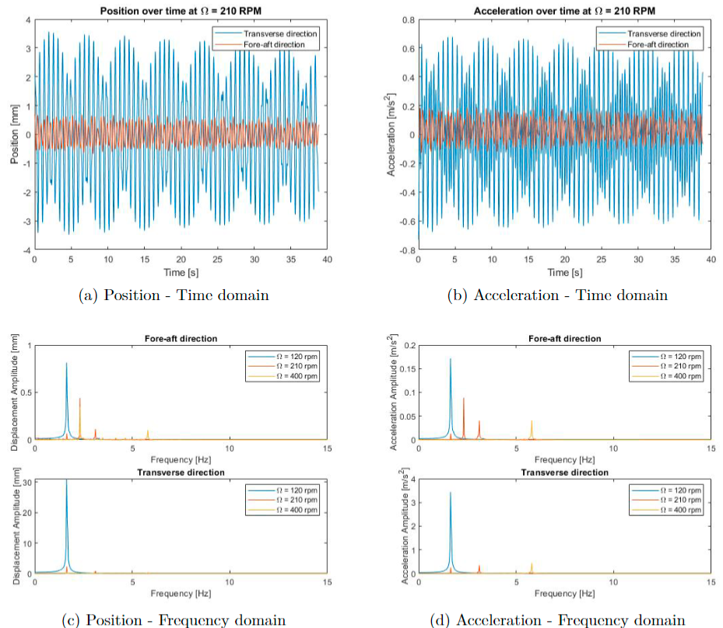
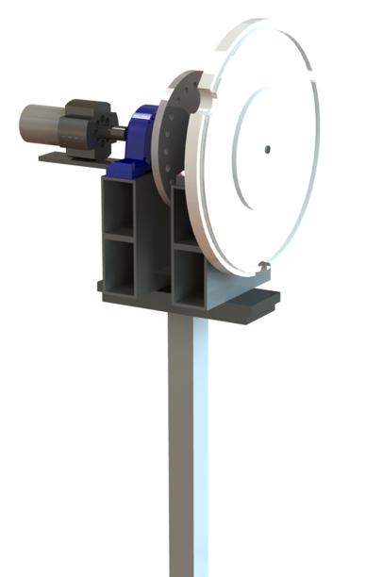
Experiment
ELEVATOR
3D RFT
2D RFT-B
Data acquisition
Extract data from excel
Subtract the mean value
Convert from V to SI units
Filter the data

Slide 16
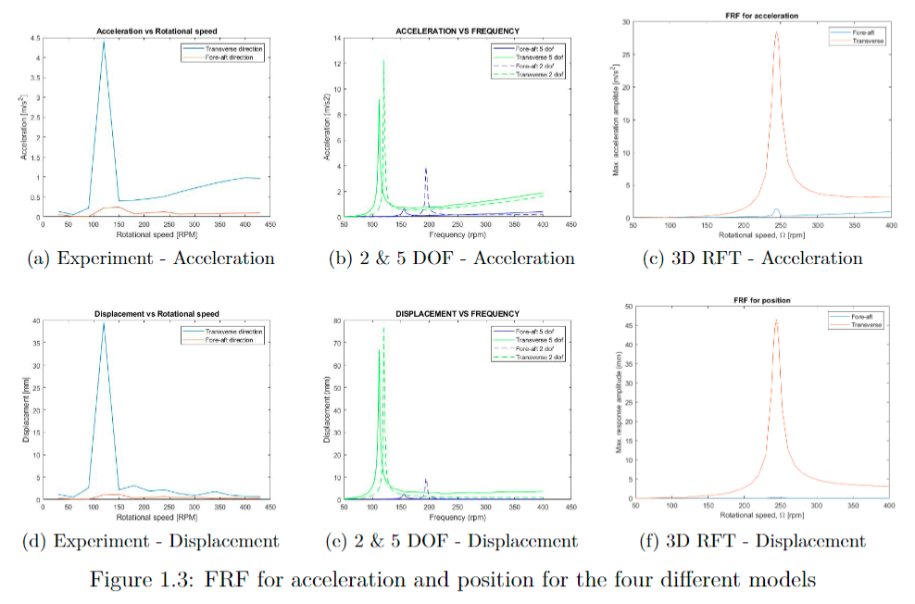
Validation & verification
ELEVATOR
3D RFT
2D RFT-B
Frequency Response Functions
Similarities
Differences

Slide 17
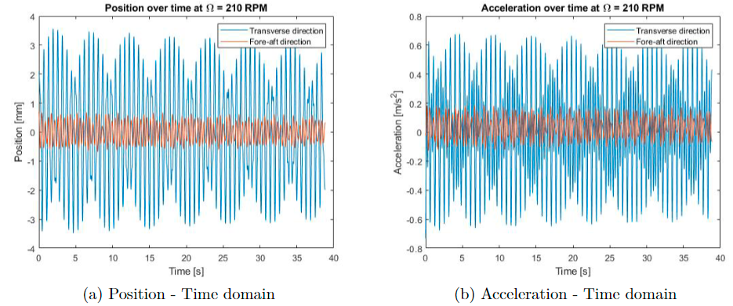
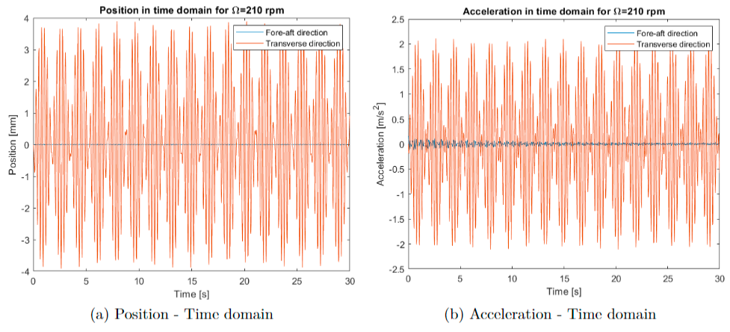
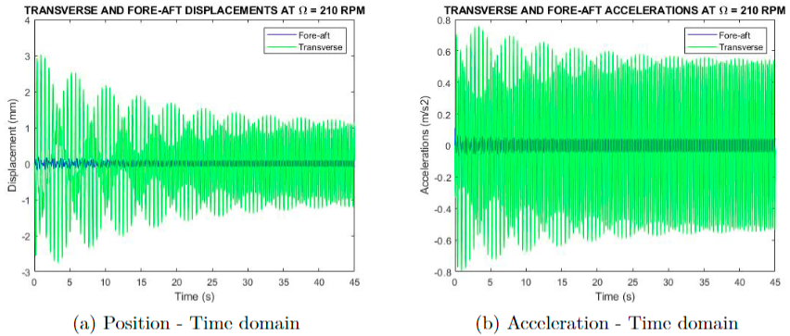
Validation & verification
Experimential data
Validation in time domain
Similarities
Differences
3D model
5DoF model

Slide 18
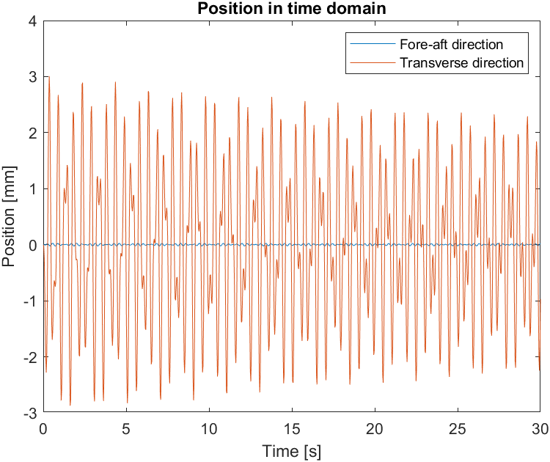
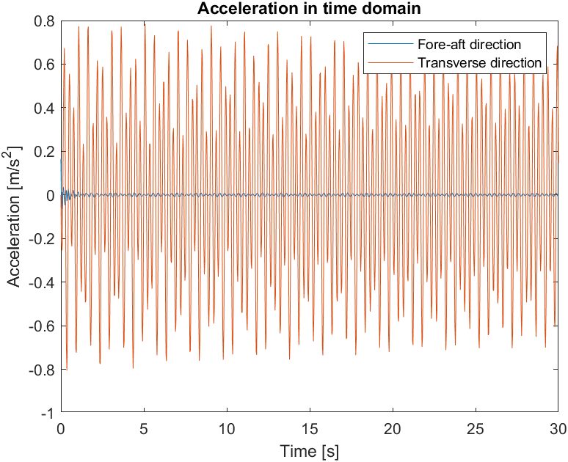
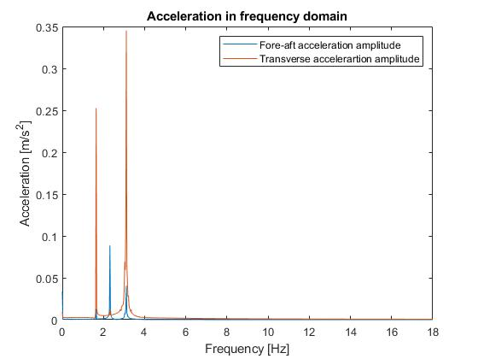
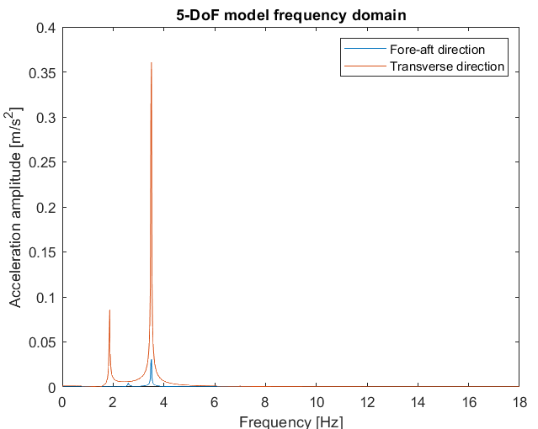
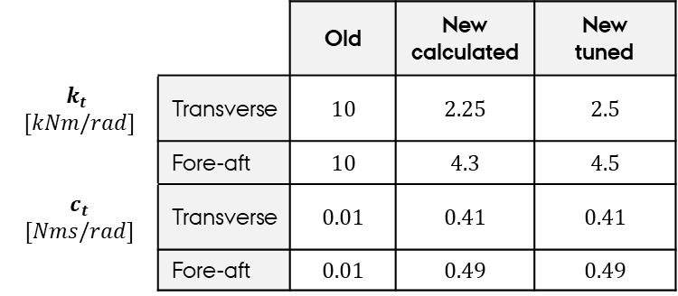
New tuned stiffness and damping
ELEVATOR
3D RFT
2D RFT-B
Ω = 210 rpm
 |  | Old | New calculated | New tuned
$$k_{t}$$ $$[kNm/rad]$$ | Transverse | $$10$$ | $$2.25$$ | $$2.5$$
 | Fore-aft | $$10$$ | $$4.3$$ | $$4.5$$
$$c_{t}$$ $$[Nms/rad]$$ | Transverse | $$0.01$$ | $$0.41$$ | $$0.41$$
 | Fore-aft | $$0.01$$ | $$0.49$$ | $$0.49$$
3D model (new)
Experiment
5 DOF model

Slide 19
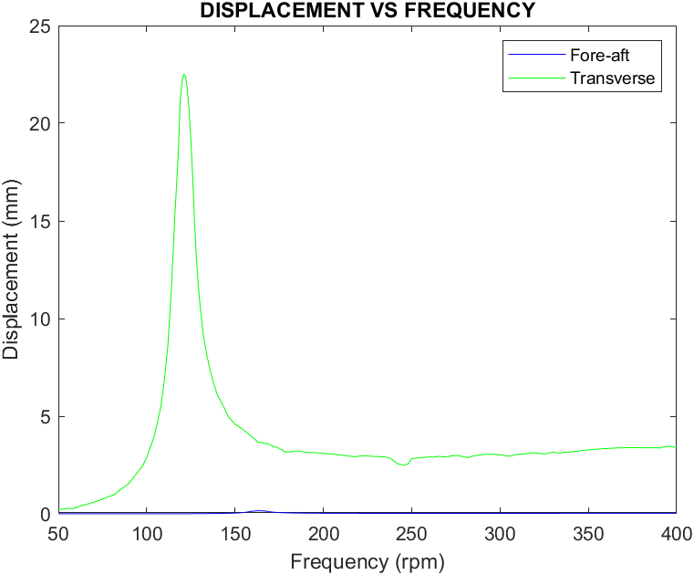
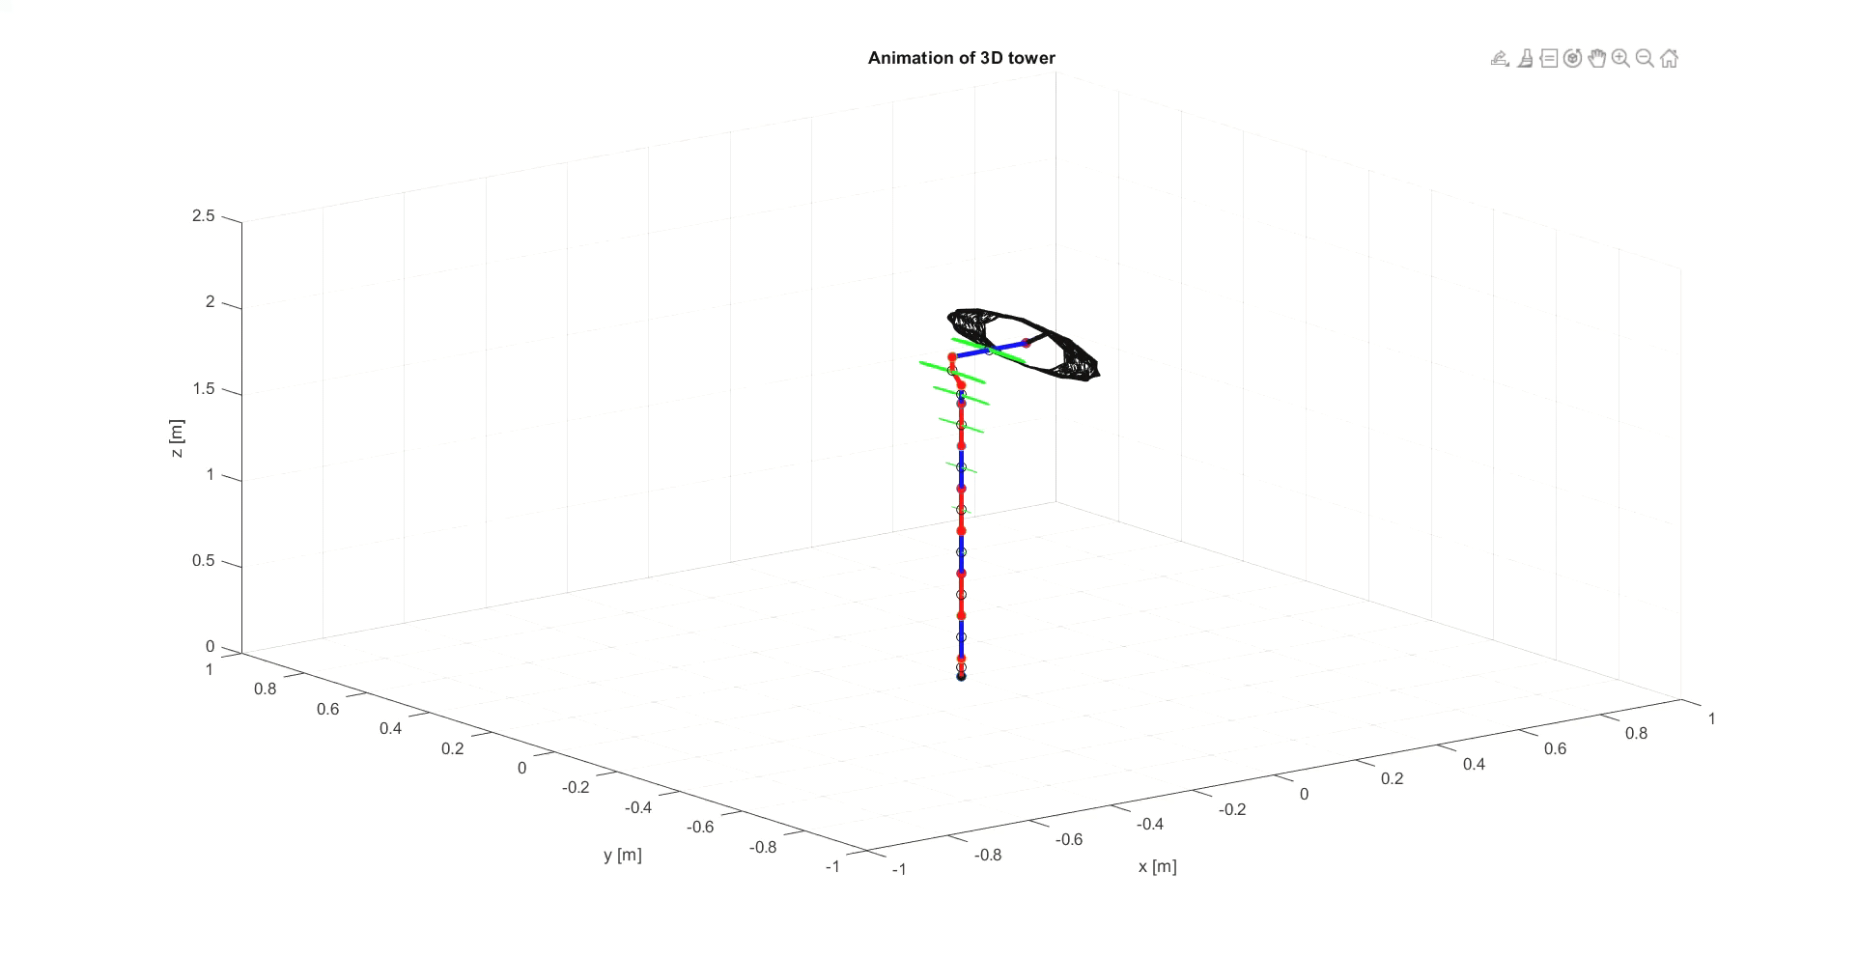
Resonance in new model

Slide 20
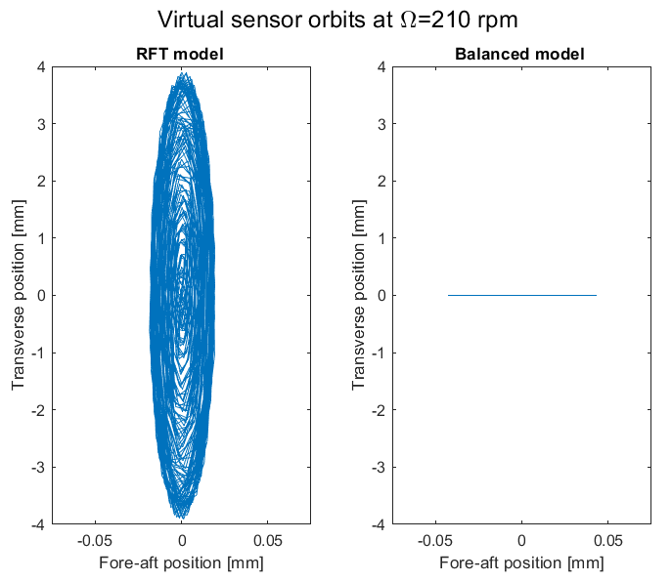
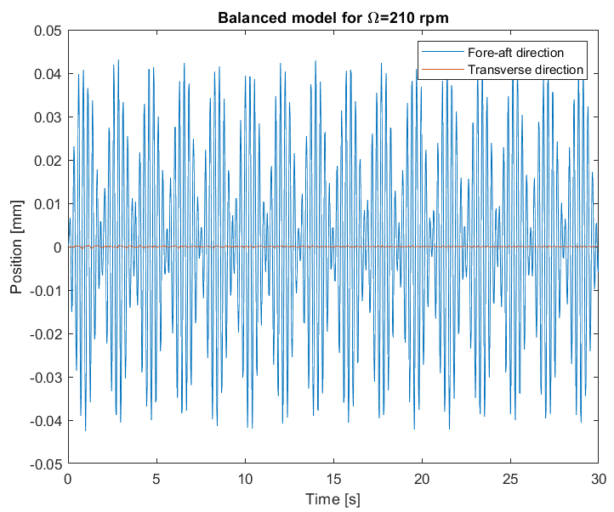
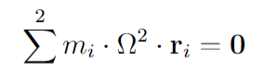
Balancing of Rotor
ELEVATOR
3D RFT
2D RFT-B

Slide 21
Conclusion
ELEVATOR
3D RFT
2D RFT-B
The 3-dimensional multibody model successfully developed for:
RFT with an unbalance mass
RFT with balancing of the rotor
Results from simulation compared with results from experiment and 2DoF/5DoF models:
The inconsistencies of the model - approximation of damping and stiffness
Tuning the damping and the stiffness

Slide 22
Wind turbine (RFT-B) 2D rotor with flexible tower and blades

Slide 23
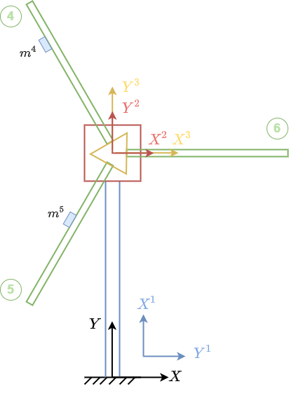
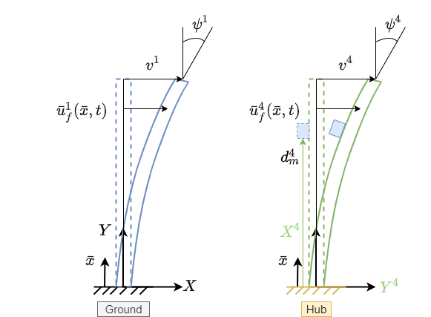
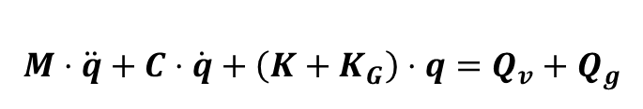
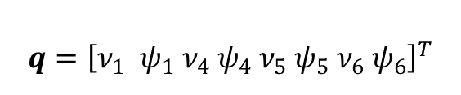
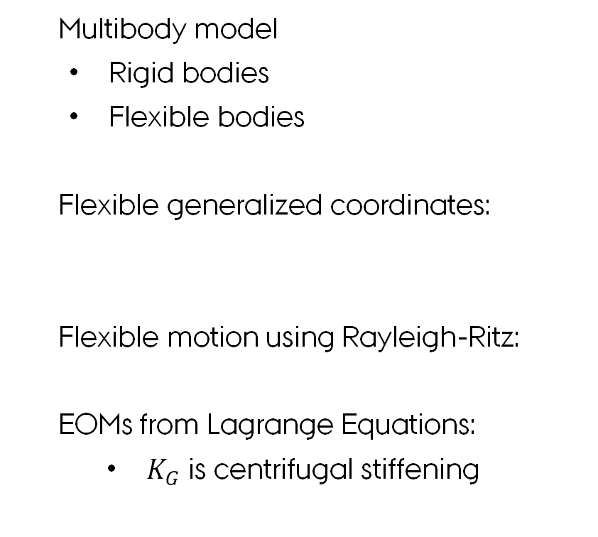
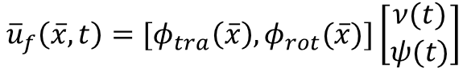
Flexible 2D model & EOMs
ELEVATOR
3D RFT
2D RFT-B
Multibody model
Rigid bodies
Flexible bodies
Flexible generalized coordinates:
Flexible motion using Rayleigh-Ritz:
EOMs from Lagrange Equations:
$K_{G}$ is centrifugal stiffening
$$q={\left[ν_{1} ψ_{1} ν_{4} ψ_{4}{ ν}_{5} ψ_{5}{ ν}_{6} ψ_{6}\right]}^{T}$$
$${\overline{u}}_{f}\left(\overline{x},t\right)=[φ_{tra}\left(\overline{x}\right), φ_{rot}(\overline{x})]\left[\begin{matrix}ν(t) \\ ψ(t)\end{matrix}\right]$$
$$M⋅\ddot{q}+C⋅\dot{q}+\left(K+K_{G}\right)⋅q=Q_{v}+Q_{g}$$
Notes:
1min:10s

Slide 24
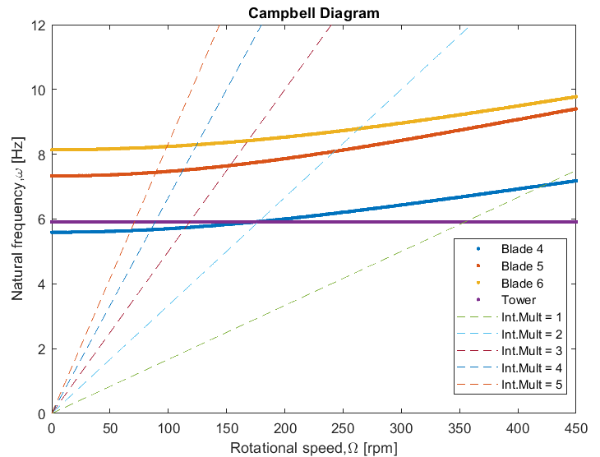
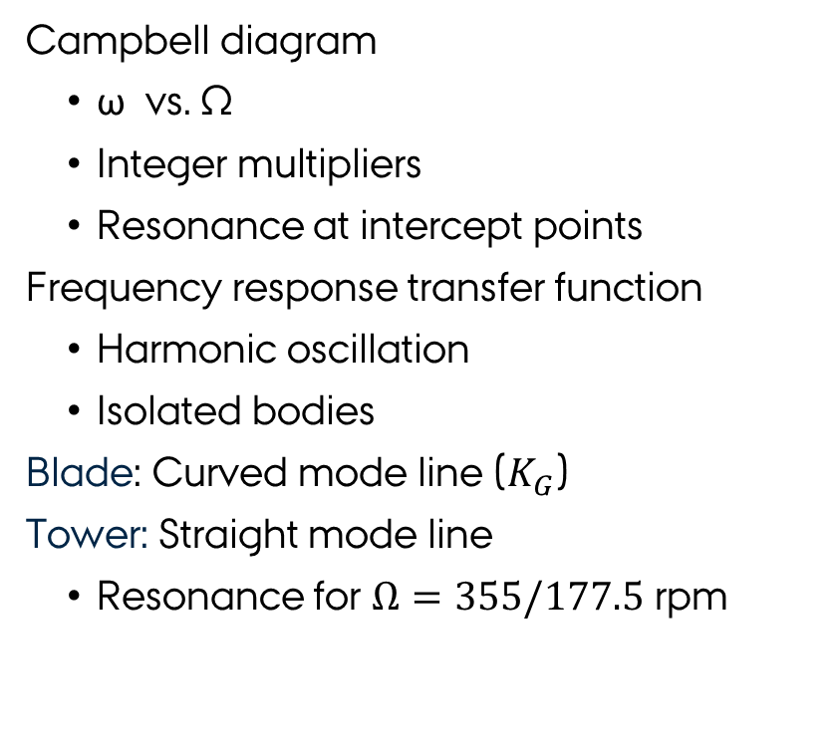
Campbell diagram
ELEVATOR
3D RFT
2D RFT-B
$$H\left(ω,Ω\right)=\frac{X}{F}=−{\left[ω^{2}M+iω\left(C−D\left(Ω\right)\right)+\left(K+K_{G}\left(Ω\right)−E\left(Ω\right)\right)\right]}^{−1}$$
Campbell diagram
ω vs. Ω
Integer multipliers
Resonance at intercept points
Frequency response transfer function
Harmonic oscillation
Isolated bodies
Blade: Curved mode line ($K_{G}$)
Tower: Straight mode line
Resonance for $Ω=355/177.5$ rpm
Notes:
Frederik

Slide 25
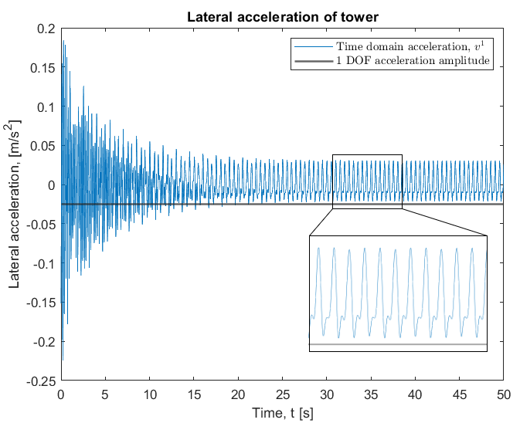
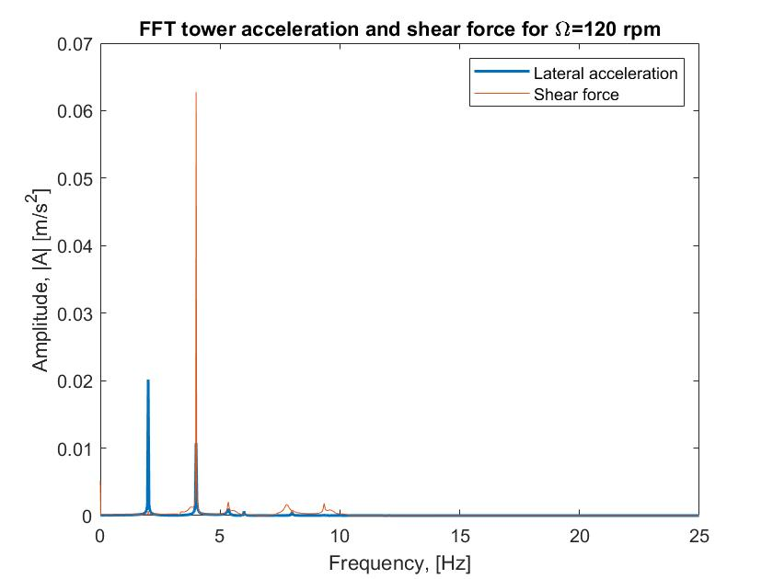
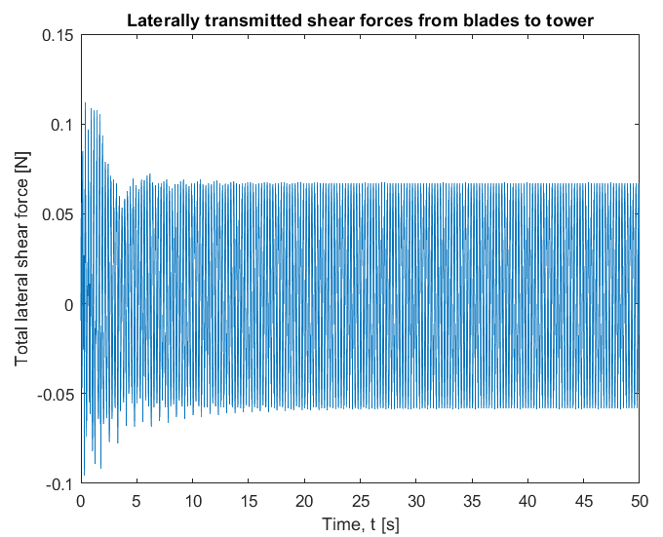
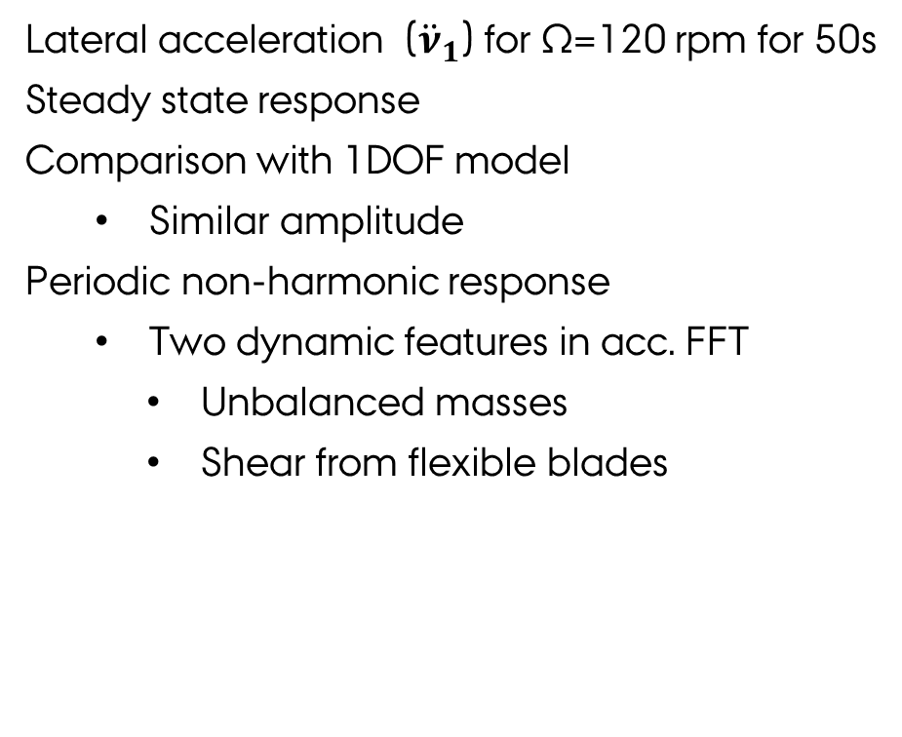
LDR of tower for Ω = 120 rpm
ELEVATOR
3D RFT
2D RFT-B
Lateral acceleration (${\ddot{ν}}_{1}$) for Ω=120 rpm for 50s
Steady state response
Comparison with 1DOF model
Similar amplitude
Periodic non-harmonic response
Two dynamic features in acc. FFT
Unbalanced masses
Shear from flexible blades
Notes:
frederik

Slide 26




LDR of tower for Ω = 20-450 rpm
ELEVATOR
3D RFT
2D RFT-B
Frequency response function (FRF)
RFT-B model
1-DOF model
Dynamic features:
Unbalanced mass
Flexible blades
Notes:
katharina

Slide 27



Fatigue analysis of blades
ELEVATOR
3D RFT
2D RFT-B
Maximum shear force:
Fatigue analysis:
$$N=K⋅σ^{m}$$
Notes:
katharina

Slide 28
Conclusion
ELEVATOR
3D RFT
2D RFT-B
Lateral acceleration dynamic features:
Excitation from unbalanced mass
Excitation flexibility of blades
FRF for tower:
Natural frequency at Ω = 322 RPM
Natural frequency from higher harmonic at Ω = 161 RPM
Fatigue analysis:
Blade 4 has lifetime of 143 cycles at 424 RPM
Notes:
katharina

